Slide 1
Scholars for Syria
GAP Project
Presented by Kristen Fowler and Kendra Mehling

Slide 2
Overview of Presentation
Introduction of issue
Introduction of project
Results and Analysis
Optional Reflection Responses
White Board Campaign
Conclusions

Slide 3
What is the Syrian Crisis?
Long-serving government vs rebel groups
March 6, 2011
April 2011
By July 2011, the Free Syrian Army had formed
Assad regime vs Rebels vs ISIS
Mass atrocities
Refugee crisis
Notes:
Conflict between long-serving government and rebel groups
Assad family has held power in Syria since 1971
Assad family is not religiously extreme
Rebels are angry about failure of long-promised economic and political reforms
Conflict began March 6, 2011 after the jailing of young protesters who painted anti-regime graffiti
Some were killed in detention, leading to public protests fueled by anger about the failure of the government to punish the perpetrator
In April 2011, the Syrian Army fired on demonstrators and the protests became a full-scale armed rebellion
By July 2011, the Free Syrian Army (FSA) had formed
Assad regime vs Rebels vs ISIS
Mass atrocities
Chemical warfare
Refugee crisis

Slide 4
Notes:
National Geographic Syrian Refugee Film

Slide 6
Why did we do this project?
- Connection to Scholars for Syria
- High percentage of Syrian students at the University of Evansville
- Awareness of general apathy and explicit hatred toward Syrians
-Compassion towards Syrians especially with respect to the current political climate
-Desire to dialogue
Notes:
Out of the S4S club came a desire to really make a change outside of the UE community
Third highest percentage of Syrian students, amazing considering our university’s overall size
Apathy, fear, ignorance, misinformed in our country
We have compassion
Dialogue is the best way to evoke learning

Slide 7
What did we do?
-Educated high school students in the EVSC about the Syrian Crisis
-Connected with Syrian students at UE to help them develop their personal stories into a presentation format
-Facilitated presentations with Syrian student volunteers
-Collected data on the impacts of programming

Slide 8
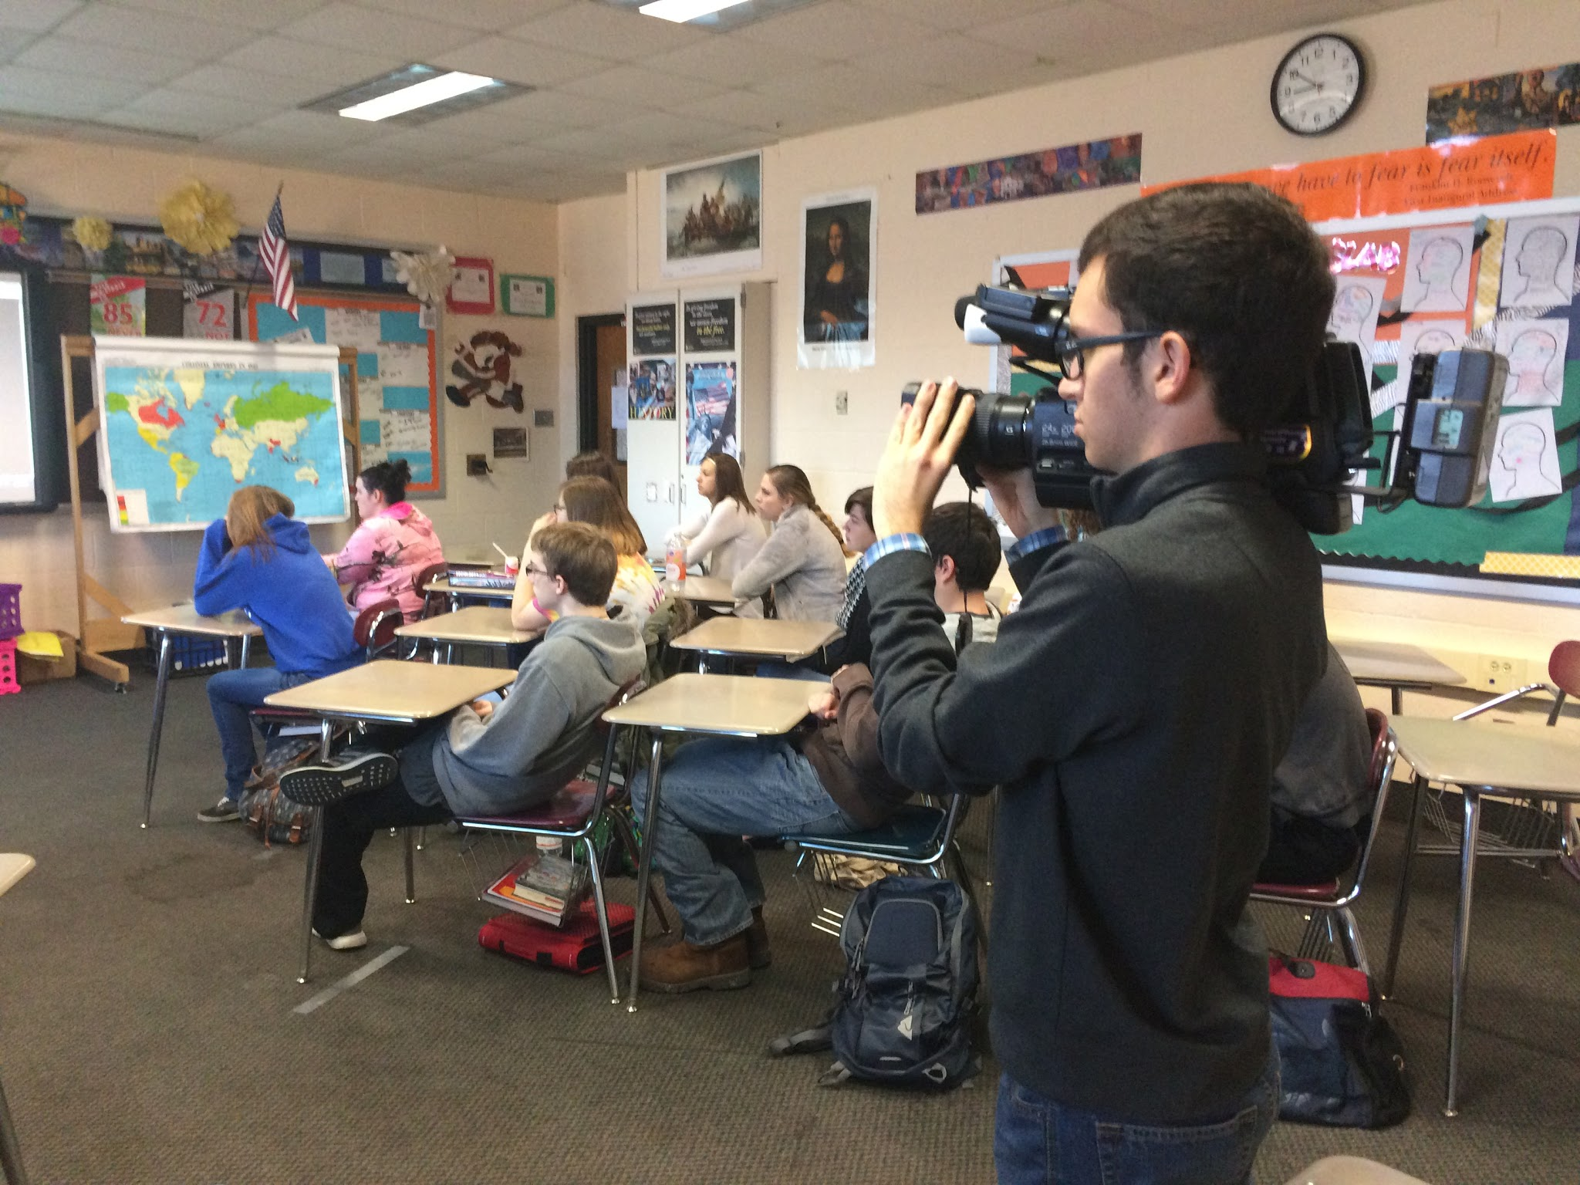
Breakdown of the “Service”
Scheduling
Pre-survey
Traveling to high schools
Presentation (link to videos)
Syrian story (30 minutes)
Question and Answer session
Post survey
White Board #standwithsyria project
- Optional Reflection Prompt

Slide 9
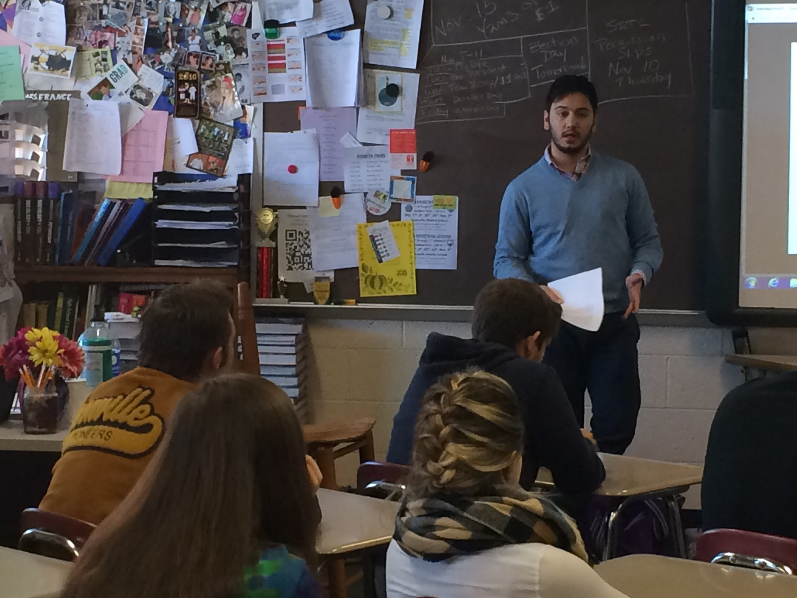
Who was involved?
Scholars for Syria
Gail Vignola
Kent Houston
Megan King
Deb Schade
Judy Quanty
Syrian Students
Hashem Hatahet
Ahmad Ismaiel
Walid Hasanato
Ghaith Safi
Aces Media Group
Jacob Lutz

Slide 10
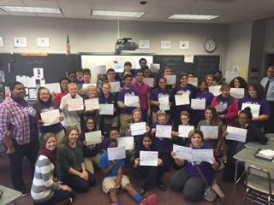
Who did it impact?
High school students
Bosse
Boonville
Castle
Mount Vernon
Memorial
Why high school students?
Eager to learn
New voters/soon to be voters
Easy influenced by social media
Notes:
High school students old enough to see the graphic nature of the crisis; topics not over their heads, they can understand the complexities of this war and the implications the war will inevitably have on Syria and the world

Slide 11
Results

Slide 12
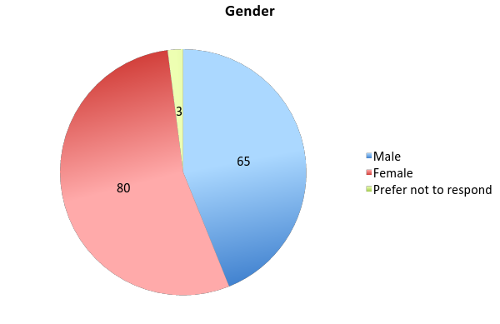
Demographics
Distribution of Students
by Academic Year
Distribution of Students
by Gender

Slide 13
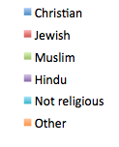
Demographics
Distribution of Students
by Ethnicity
Distribution of Students
by Religious Affiliation

Slide 14
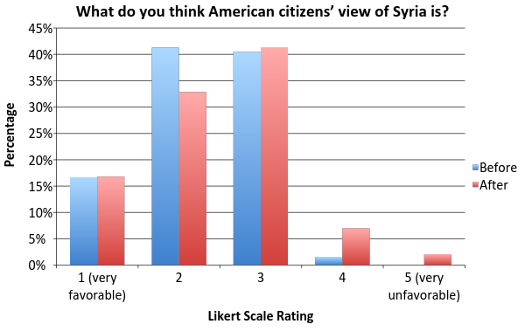

Slide 15
What comes to your mind when you hear the word Syria?

Slide 16
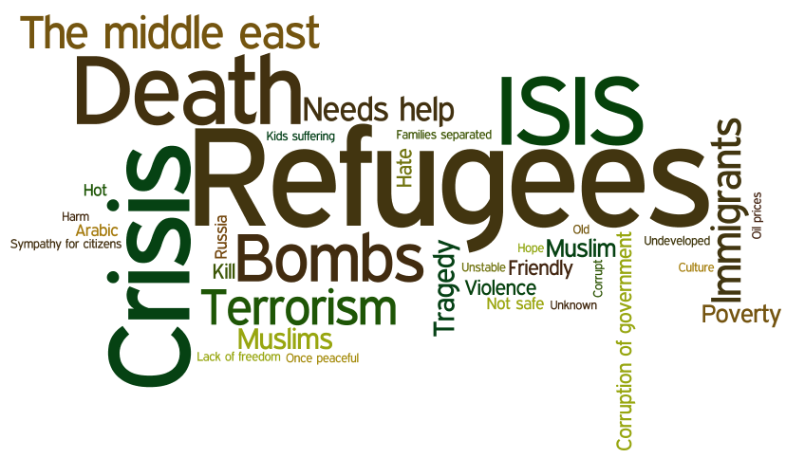
Free Response:
What do you think of when you hear the word “Syria”?
Notes:
Before:
Syrian refugees. The Syrian war taking place. Many Syrian civilians being harmed. Innocent people being killed. America’s responsibility to help.
I feel like Syria’s unique culture has been shadowed by ISIS and the civil warfare that has plagued the country for many years.
I really don’t know too much about Syria except for the fact that it’s not a great place right now.
I think of a predominantly Islamic foreign nation that is currently troubled by ISIS.
Foreign land. A lot of people with clothes that cover their faces and bodies.
Civil war. Middle east. Culture. Russia, USA. Kurdish. Unstable. Fighting.
A war torn country that would really benefit if ISIS would stop fighting everyone, also after ISIS is gone could be a beautiful country.
Not my problem.
After:
Peaceful people. We shouldn’t categorize people into groups based off of religion. But people are quick to think of ISIS.
A country full of refugees and a corrupt government all while threatened by terrorist group ISIS.
Used to be one of the most peaceful countries, but now is one of the most dangerous.
Destruction and war that is not supported by the majority of people.
Corruption and senseless fighting. Previously, my answer was ISIS.
Bad situation that is partially America’s fault.
Not so different from the rest of us.
Now when I hear Syria, I think of a country that is divided. Not all citizens partake in the fighting or the warfare. There are aspects of Syrian culture that are heart warming, like emphasis on family time.
Refugees needing to get to the states and away from the war.
I now think misinterpreted.

Slide 17
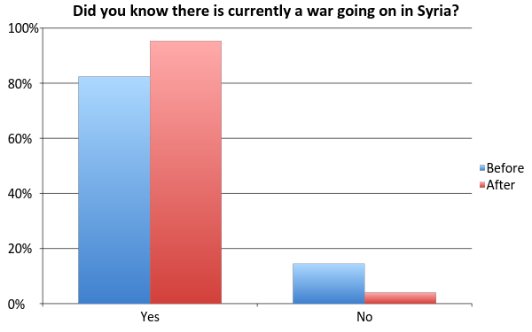
Notes:
95% after

Slide 18
Can you please explain what you know about the war?

Slide 19
Notes:
Before:
It is a civil war between ISIS and the rebel fighters.
ISIS has taken over causing citizens to flee.
Bashar al Assad is a dictator who is being opposed by a rebel group within Syria. Al Assad is backed by Russia and the USA is backing the rebels. Ceasefire agreements have failed and Russia is possibly attacking rebels, not ISIS. The kurds also have a part in it.
I don’t know anything about the war.
Involves ISIS-- many Syrians involved with ISIS; war is unfortunate, but NOT USA’s problem.
I know that there are multiple groups fighting for control of the oil wells and land in Syria. The largest and most threatening group is ISIS; many countries have vowed to fight against its bases in Syria. Innocent children are bombed or forced out of the country into refugee camps. It is mutually considered an international crisis/emergency.
Islamic radical terrorists have invaded the country in order to bring its land and people under control of ISIS. There are fundamental differences in the practice of Islam and a large divide splits the two sides because of this.
After:
The war is similar to our revolution.
A political, radical group called ISIS is attacking nearby people in order to expand its territory.
It is a political war, with the word religion used to justify acts.
I knew before the presentation that there were a lot of people killed. But now I know why, and it hurts me to know its because of what they believe.
People are getting killed for the smallest things, like even speaking their opinion.
3 groups are all fighting for power-- while global superpowers sit back and watch it happen.

Slide 20
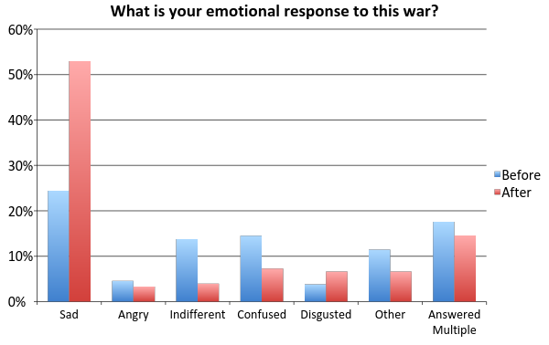
* 5 did not respond before, 1 did not respond after
Notes:
I ask you to think back to the videos you viewed earlier and recognize why students felt this way

Slide 21
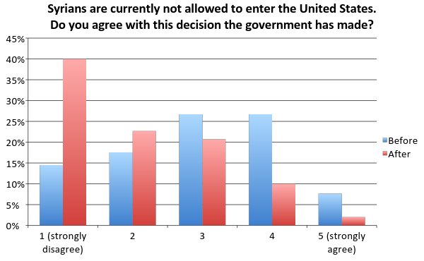
*4 people chose not to respond before, 2 after
Notes:
Stairstep decline after
Mostly 3 and 4 before

Slide 22
Why do you feel this way about their entry?
Notes:
Before:
Other countries have OPENLY stated REGRET to letting Syrian “refugees” in...cause of TROUBLE and possible terrorism.
Because we do not know who these people are trying to enter our country. While, it is terrible, we are not responsible.
I do not believe there is any way to successfully filter genuine good people from terrorists. The lives of my family and friends mean more to me than those of Syrians.
They’re people. People who are trying to escape a country where civilians are being killed as a result of this war. Fear is preventing America from doing what is right.
I think it is our duty as a super power to give aid to people in need.
I feel in order to make terrorism as low risk as possible, we need to not accept any refugees. They could be terrorists themselves or even if they aren’t, their presence will start something.
Because one bad apple doesn’t spoil the whole batch.
Many of these Syrians need a strong, safe place to live after the war trauma they’ve been through. However, there is no good way to sort out the real terrorists from the needy refugees. Terrorists in the U.S. could bring it down and cause it to fall with Syria.
So they don’t come bomb us all.
After:
Syria is very dangerous and we devalue human life when we don’t give them a chance to leave the prison that they are living in.
I believe we are a country built on immigrants and different religions. We have the resources; we should help.
Syrians are people just like us, still human. And need rights as well to feel safe.
We don’t know what they have gone through to get here or what they have seen.
I understand the fear many have about ISIS sneaking in, but it is not fair for those searching for life.
We can’t screen all of them. 99% good, but have to protect our own first against people intending to do harm.
We have enough immigrants.
I think they should be able to get out, but it’s not the USA’s job so I understand the government’s point of view.

Slide 23
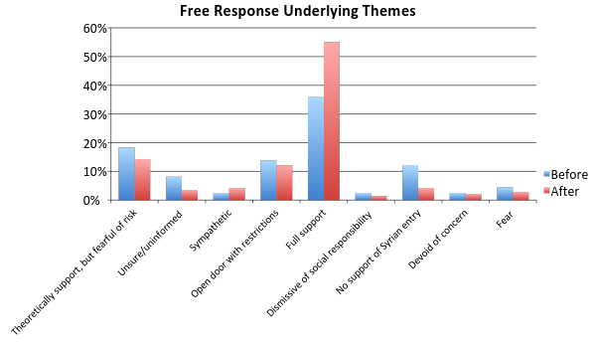
Syrians are currently not allowed to enter the United States. Do you agree with this decision? Why do you feel this way about their entry?
Notes:
Full support first
Decline in theoretical support and open door with restrictions, presumably moved to full support
Decline in unsure/uninvolved implies we did successfully synthesize learning
Increase in sympathy
Decrease is no support of Syrian entry, which is exactly what we would have hoped for
Dismissive of social responsibility, devoid of concern, and fear did not change

Slide 24
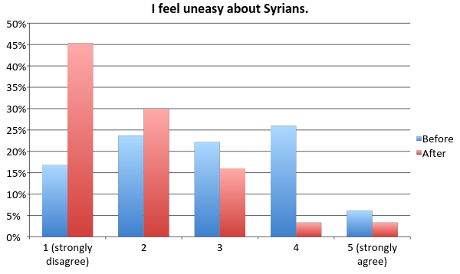
* 2 did not respond before

Slide 25
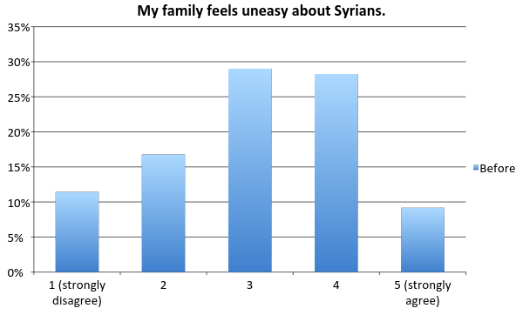
*2 did not respond before and after

Slide 26
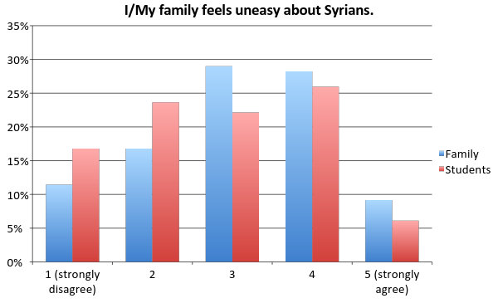

Slide 27
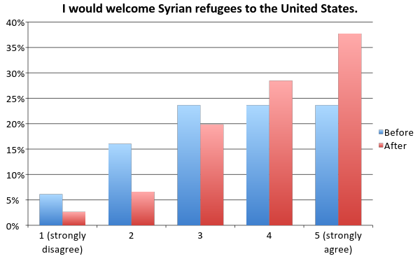
* 3 did not answer before, 1 after

Slide 28
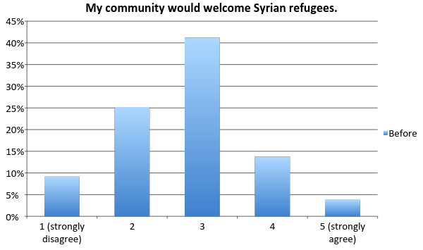
*4 did not answer

Slide 29
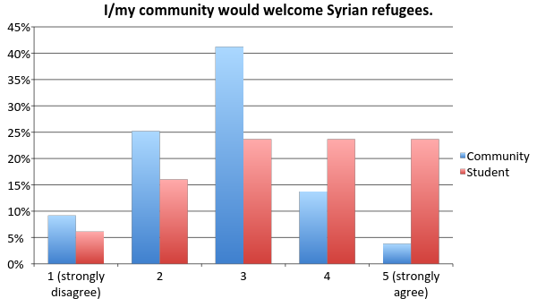
Notes:
We decided to combine these two to see what differences were revealed between students’ own conceptions and conceptions of their community… powerlessness

Slide 30
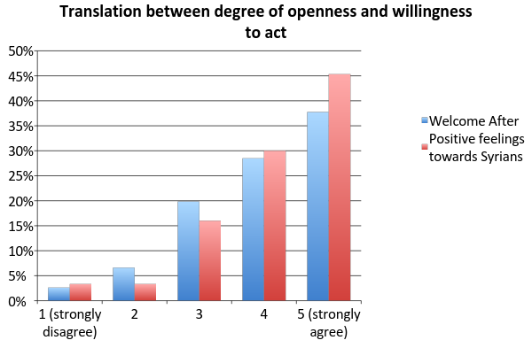
Notes:
Positive feelings towards syrians against how likely they would be to welcome Syrians into america. Do actions speak louder than words? Although both of these responses increased positively, they did not increase in a parallel manner. This shows a discrepancy between what we as a society feel and what we choose to act upon.

Slide 31
Optional Reflection Responses

Slide 32
Why should people care about the events going on in Syria?
Notes:
The majority of people don't care because they think out of sight out of mind.
I think the Syrians are misunderstood in the world. I think they are seen as people of war, in the real case they are regular people trying to survive with the environment they are surrounded by.
I don’t think people realize how much Russia and the U.S. are making things worse. People should care that their government namely the U.S. is supposed to not extort other smaller powers but that’s not the case. I do get that our government is making use of an advantageous situation but sometimes we need to do the right thing just for the sake of it being right.
People are terrified when they hear the word Syrian. Immediately, minds jump to conclusions and bodies shake with fear. Many people stereotype Syrians due to past experiences with them like 9/11. Although, there have been many terrorists that are Syrians, it is important for people to be informed before making judgements about the group. Some Syrians are terrorists, but some are also great people. Stereotyping has been a problem in the world for many years now. People continually jump to conclusions and judgements and this will most likely never change due to the fact it is the psychology of the human brain.
People should care about what is going on in Syria because that could happen here in the United States at anytime. People shouldn’t be too worried at the moments because the United States isn’t letting people from Syria into our country due to fear of terrorists. We don’t have a problem right now with terrorists but it could become a problem at anytime and we are preparing for it. We are doing good with not letting them into the country but also not all Syrians are terrorists.
It should matter because if it were us they would maybe do the same.
Why shouldn’t people care? Why is this even a question?! They are human beings!.
Most people probably don’t actually care. Our society is full of sensationalism and Syria seems to be one of the current sensations.

Slide 33
Why are people scared when they hear the word “Syrian”?
Why is it important for people to be informed before making judgements about a group of people?
Notes:
I think people are scared when they hear the word “Syrian” because they are not familiar with the culture or the Syrian people. It is important to be informed so you can make judgements that you believe in.
Many are scared of Syrians because often uneducated people relate race with “terrorists”. This image has placed a burden on many innocent people which is why it is important to be informed before making judgements.
People believe Syrians are terrorists and that if we allow them into America it could lead to another terrorist attack.
They think of ISIS.
Terrorists. They need a chance.
Because all you hear is bad things about Syrian people.
When people hear ‘Syrian’ they think of Isis and people being killed. I know this because that is what I thought before the presentation. Because of the presentation I learned that some people aren’t apart of this group and people shouldn’t be scared of them. The student that spoke to us told us that the citizens in Syria have to choose a side or else they are in danger of being killed.

Slide 34
How important is education?
How do you feel knowing that children in refugee camps are in danger of growing up without access to education? What are the dangers of a lack of education?
Notes:
Education is very important; it shape our future. I feel sad that this is happening to children in Syria. The dangers of a lack of education to me mean more poverty. More poverty means more criminal activity.
I think every child and person should have access to education and sources of knowledge. When knowledge is spread it is means for progress.
If you don’t have education, you don’t have the basic skills to live.
Education is fundamental in today’s society. It allows us the chance to form our own views based on actual facts instead of assumptions. Knowing that children aren’t provided with this opportunity both scares and saddens me. Those children will grow without any idea of what actually is happening in the world and believing lies told by those who do not have their best interest at heart.

Slide 35
Whiteboard Campaign
Link to whiteboard video here
#standwithsyria
Notes:
This was an outlet we wanted to pursue because students are familiar with social media and we wanted our approach to be relevant to their world so to speak.

Slide 36
Conclusion
Review
Background information
Project Details
Results and analysis
Every question before and after changed significantly
Increased knowledge base
Decreased negative reactions/feelings
Increased positive reactions/feelings
Fear and hatred
More ingrained emotional responses
Minority both before and after presentation

Slide 37
Sustainability
Replicable
Programming evaluation
Interest shown by additional high schools
Photos and videos are permanent tools for educating
Education
“Human behavior flows from three main sources: desire, emotion and knowledge.” -Plato
Knowledge can be shared continuously; “Domino Effect”

Slide 38
Closing Remarks
Future implications and directions
Need for further educational intervention
Evident impact
Notes:
Lastly we want to end with a principle that we often forget or neglect in our society today: basic human rights

Slide 39
#standwithsyria
Because we are all human

